Slide 1

Decompositions
By Tomer Sheffer & Roni Ben Dom

Slide 2
Matrix decomposition
In mathematics, factorization, or factoring is writing a number or another mathematical object as product of several factor usually of the same kind
Matrix decomposition, also named matrix factorization is writing a matrix as a product of metrices

Slide 3

Cholesky decomposition
Cholesky decomposition is a decomposition of symetric, positive definite matrix into a product of a lower triangular matrix and its transpose
$$\left(\begin{matrix}a_{1, 1} & a_{1, 2} \\ a_{2,1} & a_{2, 2}\end{matrix}\right)=\left(\begin{matrix}l_{1,1} & 0 \\ l_{2,1} & l_{2,2}\end{matrix}\right) ×\left(\begin{matrix}l_{1,1} & l_{2, 1} \\ 0 & l_{2,2}\end{matrix}\right)$$

Slide 4

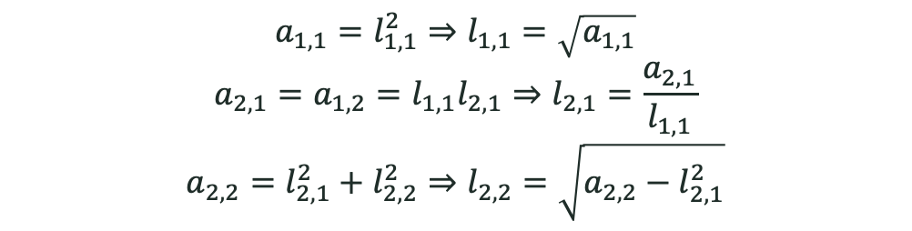
Cholesky decomposition – Algorithm example
$$\left(\begin{matrix}a_{1, 1} & a_{1, 2} \\ a_{2,1} & a_{2, 2}\end{matrix}\right)=\left(\begin{matrix}l_{1,1} & 0 \\ l_{2,1} & l_{2,2}\end{matrix}\right) ×\left(\begin{matrix}l_{1,1} & l_{2, 1} \\ 0 & l_{2,2}\end{matrix}\right)=\left(\begin{matrix}l_{1,1}^{2} & l_{2,1}l_{1,1} \\ l_{2,1}l_{1,1} & l_{2,1}^{2}+l_{2,2}^{2}\end{matrix}\right)$$
$$a_{1,1}=l_{1,1}^{2}⇒l_{1,1}=\sqrt{a_{1,1}}$$
$$a_{2,1}=a_{1,2}=l_{1,1}l_{2,1}⇒l_{2,1}=\frac{a_{2,1}}{l_{1,1}}$$
$$a_{2,2}=l_{2,1}^{2}+l_{2,2}^{2}⇒l_{2,2}=\sqrt{a_{2,2}−l_{2,1}^{2}}$$

Slide 5
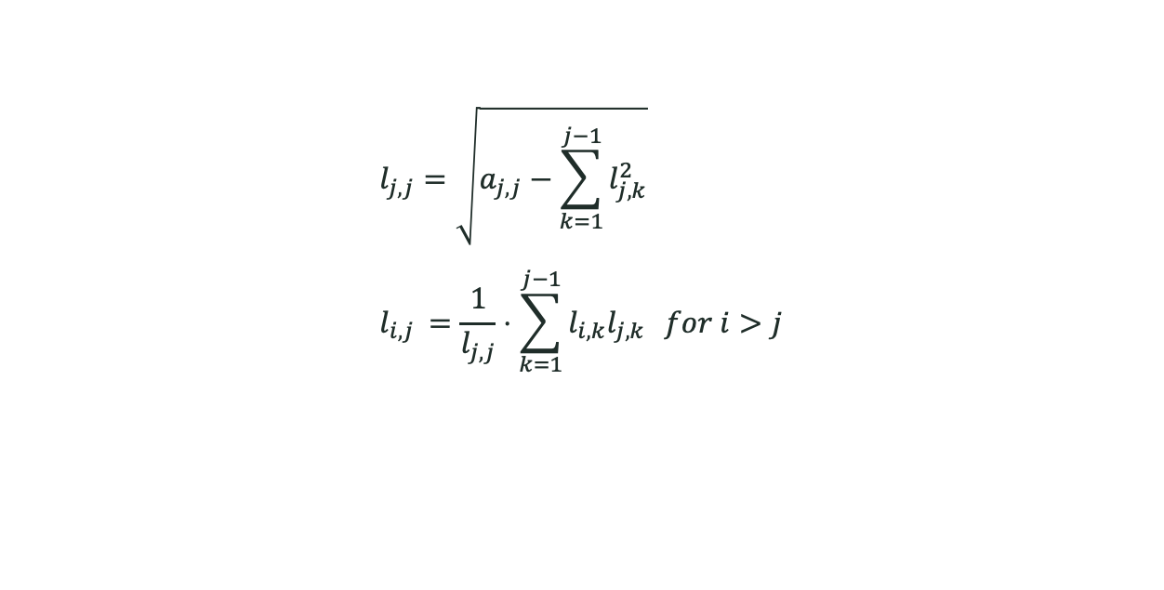
Cholesky decomposition – Algorithm
$$l_{j,j}=\sqrt{a_{j,j}−\sum_{k=1}^{j−1}{l_{j,k}^{2}}} \\ l_{i,j }=\frac{1}{l_{j,j}}⋅\sum_{k=1}^{j−1}{l_{i,k}l_{j,k}} for i>j$$

Slide 6
Cholesky decomposition - Usages
Cholesky decomposition has different usages, such as:
Monte-Carlo simulations
Kalman filters
Matrix inversion
We will focus on one very related to the course materia, a line search method called Quasi-Newton method.

Slide 7

Newton methods - recap
Recal that in Newton’s method we perform the following update at each iteration:
$x_{k+1}=x_{k}−{H\left(x_{k}\right)}^{−1}∇f\left(x_{k}\right)$
In practice, each iteration involves solving the linear system:
$$H\left(x_{k}\right)⋅p_{k}=−∇f\left(x_{k}\right)$$
Where $p_{k}$ is the unknown - the Newton direction

Slide 8

Quasi-Newton methods
In Quasi-Newton methods, instead of computing the actual hessian, we approximate it, the approximation must satisfy the Quasi-Newton condition (Secant equation):
$$B_{k+1}⋅\left[x_{k+1}−x_{k}\right]= ∇f\left(x_{k+1}\right)−∇f\left(x_{k}\right)$$
Where $B_{k+1}$ is the approximation of the hessian in step k+1

Slide 9

Quasi-Newton methods
Consider the following quadratic model:
$$m_{k}\left(p\right)={f(x}_{k})+∇f(x_{k})^{T} p+\frac{1}{2}p^{T}B_{k}p$$
Where $B∈ℝ^{\left(n×n\right)}$ symetric positive definite.
This model satisfies:
$m_{k}\left(0\right)={f(x}_{k})$
$∇m_{k}(0)=∇{f(x}_{k})$

Slide 10

Quasi-Newton methods
$$\text{Minimizing} \text{this} \text{model} \text{yields}\text{:}$$
$$∇m_{k}=∇f(x_{k})+B_{k}p_{k}=0⇒p_{k}=−B_{k}^{−1}∇f(x_{k})$$
This minimizer, $p_{k}$ is used as the new search direction.
The new iterate is $x_{k+1} = x_{k} +α_{k}p_{k}$, where the step length $α_{k}$ is chosen to satisfy the Wolfe conditions.
Notes:
This iteration is almost similar to the line search Newton method. The key difference is that the approximate Hessian $B_{k}$ is used in place of the true Hessian.

Slide 11

Quasi-Newton methods
Suppose that we have generated a new iterate $x_{k+1}$ and wish to construct a new quadratic model, an approximate quadratic model of $f$of the form:
$m_{k+1}\left(p\right)={f(x}_{k+1})+∇f(x_{k+1})^{T}p+\frac{1}{2}p^{T}B_{k+1}p$
Requiring the following:
${∇m}_{k+1}\left(0\right)={∇f(x}_{k+1})$
$∇m_{k+1}(−αp_{k})={∇f(x}_{k})$
Notes:
Instead of computing a new B at every iteration, we want to update it in a simple manner, taking into to account the curvature measured during the most recent step

Slide 12

Quasi-Newton methods
$$∇m_{k+1}(−αp_{k})={∇f(x}_{k}):$$
$$∇m_{k+1}\underset{{}_{=−αp_{k}}}{(\underbrace{x_{k}−x_{k+1}}})=∇f(x_{k+1})−α_{k}B_{k+1}p_{k}=∇f(x_{k})⇒ \\ ∇f(x_{k+1}) −∇f(x_{k})=B_{k+1}α_{k}p_{k}$$
Define:
$s_{k}=x_{k+1}−x_{k}=α_{k}p_{k}$
$y_{k}= ∇f(x_{k+1}) −∇f(x_{k})$
Notes:
Instead of computing a new B at every iteration, we want to update it in a simple manner, taking into to account the curvature measured during the most recent step

Slide 13

Quasi-Newton methods: Secant equation
We get:
$$y_{k}=B_{k+1 }s_{k}$$
This is known as the Quasi-Newton condition, or Secant equation.
All quasi-Newton methods must share and satisfy this condition
Notes:
Instead of computing a new B at every iteration, we want to update it in a simple manner, taking into to account the curvature measured during the most recent step

Slide 14

Update the hessian approximation
There are numerous methods to update $B$, the hessian approximation:
BFGS
DFP
Symmetric rank-one update (SR1)
etc…
Where does Cholesky decomposition comes in handy?

Slide 15

Cholesky decomposition in Quasi-Newton methods
Updating the Cholesky decimposition of the Hessian approximation rather than the Hessian approximation itself has some benefits:
Avoiding round off errors, which can cause loss of positive deffinitness of the approximation of the Hessian
Reduces time complexity of the calculation $O(n^{3})→O(n^{2})$

Slide 16

SVD – Singular Value Decomposition
A factorization of a real or complex matrix $M$ of the following form:
$$M=UΣV^{∗}$$
Where:
$U∈ℂ^{m×m} −$ Unitary matrix (orthogonal if $M$ is real)
$Σ∈ℂ^{m×n}−$Diagonal matrix with non-negative real numbers on the diagonal
$V∈ℂ^{n×n}−$Unitary matrix (orthogonal if $M$ is real)

Slide 17
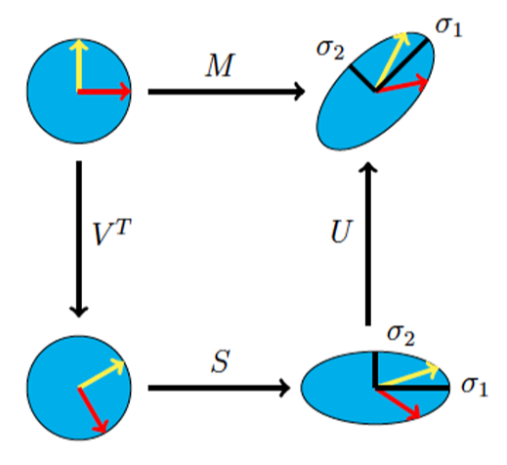





SVD
We will focus on real matrices:
$$M=UΣV^{T}∈ℝ^{m×n}$$
The geometric interpretation of SVD decomposition:
$$Rotation$$
$$Rotation$$
$$Σ$$
$$Scaling$$

Slide 18

SVD
Simple example:
$A=\left(\begin{matrix}4 & 4 \\ −3 & 3\end{matrix}\right)$
$AA^{T}$ is real and symmetric and therefore diagonalizable:
$$A^{T}A=VΛV^{T}=\frac{1}{\sqrt{2}}\left(\begin{matrix}1 & 1 \\ −1 & 1\end{matrix}\right)\left(\begin{matrix}32 & 0 \\ 0 & 18\end{matrix}\right)\frac{1}{\sqrt{2}}\left(\begin{matrix}1 & −1 \\ 1 & 1\end{matrix}\right)$$
Therefore:
$$Σ=\left(\begin{matrix}\sqrt{18} & 0 \\ 0 & \sqrt{32}\end{matrix}\right), U=AVΣ^{−1}=\left(\begin{matrix}0 & 1 \\ −1 & 0\end{matrix}\right)$$

Slide 19

SVD
Therefore the SVD decomposition is:
$$A=UΣV^{T}=\left(\begin{matrix}0 & 1 \\ −1 & 0\end{matrix}\right)\left(\begin{matrix}\sqrt{18} & 0 \\ 0 & \sqrt{32}\end{matrix}\right)\left(\begin{matrix}\frac{1}{\sqrt{2}} & \frac{1}{\sqrt{2}} \\ −\frac{1}{\sqrt{2}} & \frac{1}{\sqrt{2}}\end{matrix}\right)$$

Slide 20

PCA for Dimensionality reduction
PCA – Principal component analysis
Assume we have a dataset matrix $X=\left(\begin{matrix}x_{1,1} & ⋯ & x_{1,n} \\ ⋮ & ⋱ & ⋮ \\ x_{m,1} & ⋯ & x_{m,n} \end{matrix}\right)∈ℝ^{m×n}$
$m$ instances of $n−$dimensional feature vectors
Our data might include features that contain major amount of information (the principal components), while the others contain only minor amount of information
SVD helps us to identify the principal components of our data

Slide 21

PCA for Dimensionality reduction
We perform SVD on the covariance matrix of our dataset:
$$Σ=\frac{1}{m}X^{T}X$$
The implication is finding the principle eigenvalues of $Σ$, which correlate to the variance of each feature
Features with higher variance carry more information on the data
We drop features with low eigenvalue\variance to reduce computation and storage efforts

Slide 22

Dimensionality reduction in PCA
Example $\#1$
2D dataset
Example $\#2$
PCA on images

